Slide 1
Github Assistant
For Collaborative Development

Slide 2
Problem Statement
Conversational interface for github
Create Repository
Add github users as collaborators to a repository
Create Issues in a project
Get List of open issues in a project
Interface to Message Other users
Send and receive messages from other users
Send commands to the bot while messaging other users
The response from the bot needs to be visible to both users

Slide 3
Interface
Ux demo
Heroku url
https://github-assistant-slack.herokuapp.com

Slide 4
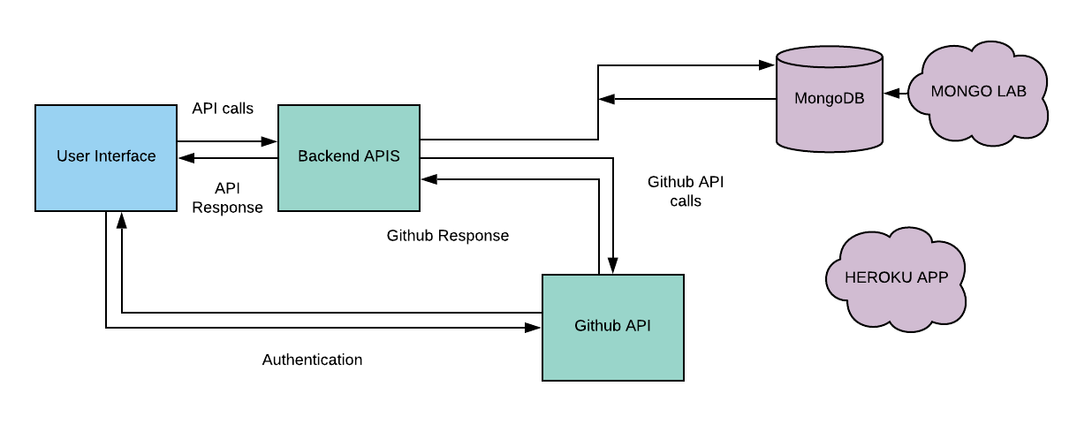
Architecture

Slide 5
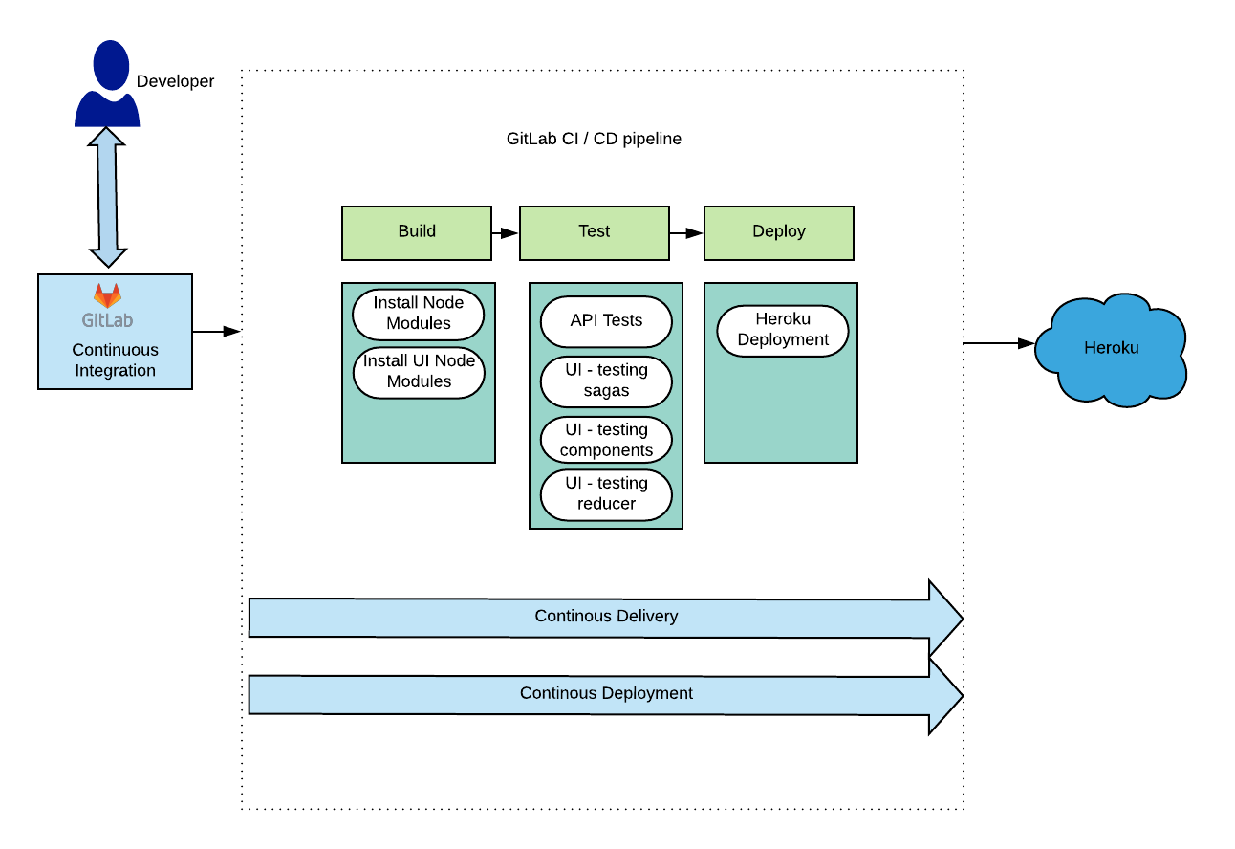
CI / CD

Slide 6
Technology Stack

Slide 7

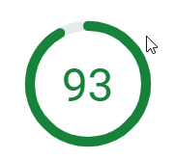
Performance
Desktop score: 99 | Network download : 215 KB | Mobile scroe: 93
https://developers.google.com/speed/pagespeed/insights/?url=https%3A%2F%2Fgithub-assistant-slack.herokuapp.com%2F&tab=desktop | https://developers.google.com/speed/pagespeed/insights/?url=https%3A%2F%2Fgithub-assistant-slack.herokuapp.com%2F&tab=mobile

Slide 8
Accessibility
Made the app web accessible.
Ensured there are 0 errors and 0 warnings as per the WAVE tool.
Ensured all the links have prominent visibility(outlines).
Ensured the page is accessible by using keyboard alone.

Slide 9
Backlog
Separate Login screen to support multiple login actions via Google+ and Facebook
Option to support much more GitBot features – adding comments to an existing issue, Able to merge PR requests, add comment on any existing pull requests
Immediate Feedback for GitBot actions
Show Available Users - if the users are currently online
Show #github bots commands in the UI/Message panel

Slide 10
Questions and Feedbacks
Suggestion to improve the app experience ..?

Slide 11
Thank You

